Slide 1
Carbon
September 24, 2019

Slide 2
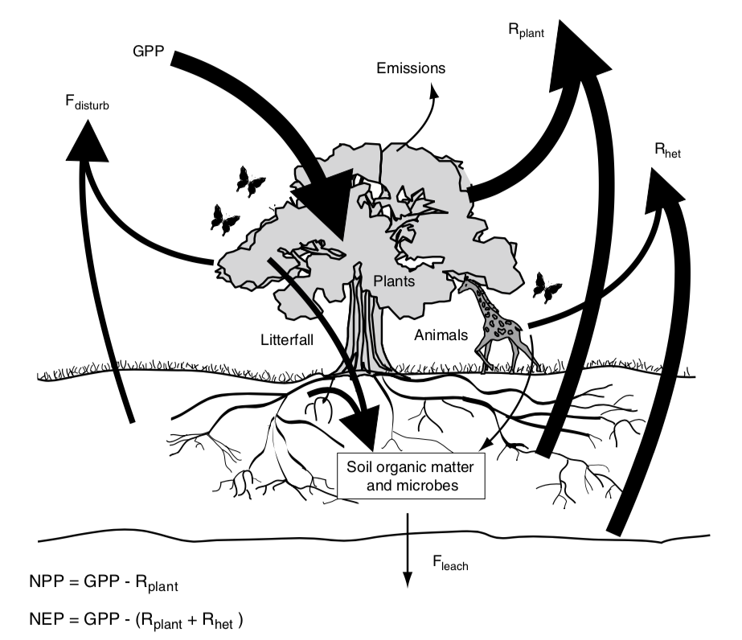
Terrestrial Ecosystem Carbon Cycle

Slide 3
Terrestrial Ecosystem Carbon Cycle
Arrows represent fluxes
How do these compare to anthropogenic carbon fluxes?

Slide 4
Terrestrial Ecosystem Carbon Cycle

Slide 5
NPP = GPP - R_{plant}

Slide 6
NPP = GPP - R_{plant}
Net Primary Productivity (C into plants – C out of plants; per ground area)

Slide 7
NPP = GPP - R_{plant}
Gross Primary Productivity (total flux of C into plants; per ground area)

Slide 8
NPP = GPP - R_{plant}
Plant Respiration (total flux of C out of plants ; per ground area)

Slide 9
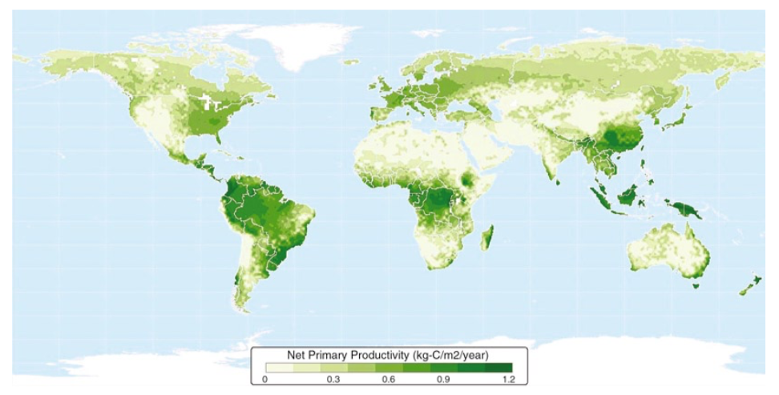

Slide 10
NPP = GPP - R_{plant}
Gross Primary Productivity (total flux of C into plants; per ground area)

Slide 11
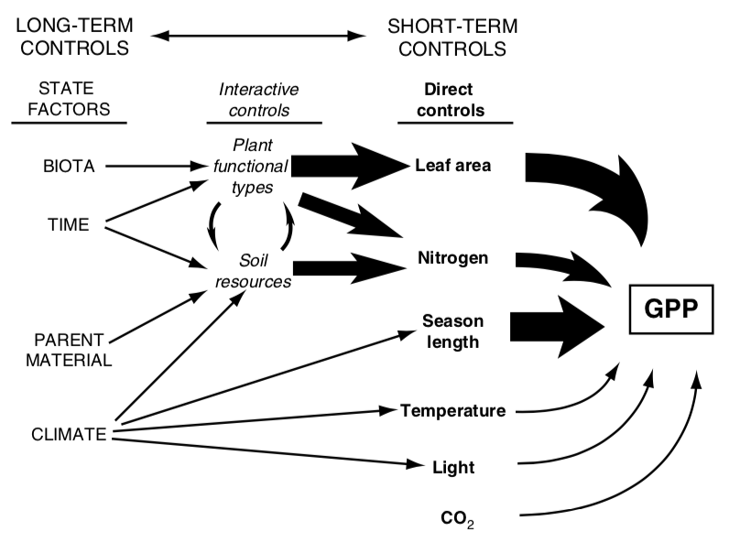

Slide 12
GPP = photosynthesis * LAI

Slide 13
GPP = photosynthesis * LAI
Carbon in to leaves (per leaf area)

Slide 14
GPP = photosynthesis * LAI
Leaf area index (leaf area per ground area)

Slide 15
GPP = photosynthesis * LAI
Carbon in to leaves (per leaf area)

Slide 16
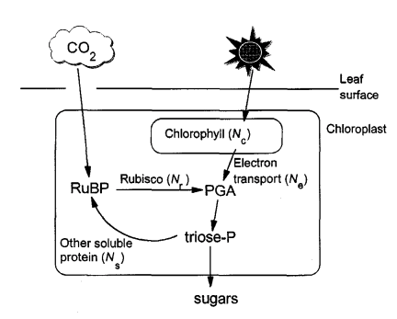
Simple recap of photosynthesis
Medlyn 1996

Slide 17
Simple recap of photosynthesis
Medlyn 1996

Slide 18
Photorespiration
Rubisco : RibUlose – 1,5 – BISphosphate Carboxylase and Oxygenase
Catalyzes CO₂ and O₂
Catalyzing O₂ leads to “wasteful” respiration (loss of CO₂)
Increases as O₂ increases
Increases with temperature

Slide 19
3 types of photosynthesis systems
C₃: what we already covered
Most plants
C₄: Separate carbon acquisition and sugar creation in space
Typically grasses
CAM: Separate carbon acquisition and sugar creation in time
E.g., Cacti

Slide 20
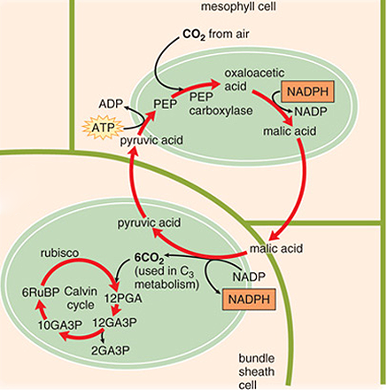
C4 photosynthesis
PEP carboxylase captures CO₂ and creates a 4 carbon sugar in mesophyll
Moves sugar to bundle sheath, where CO2 is removed
Bundle sheath cells surround veins
Calvin cycle progresses as normal
“Costs” two extra ATPs

Slide 21
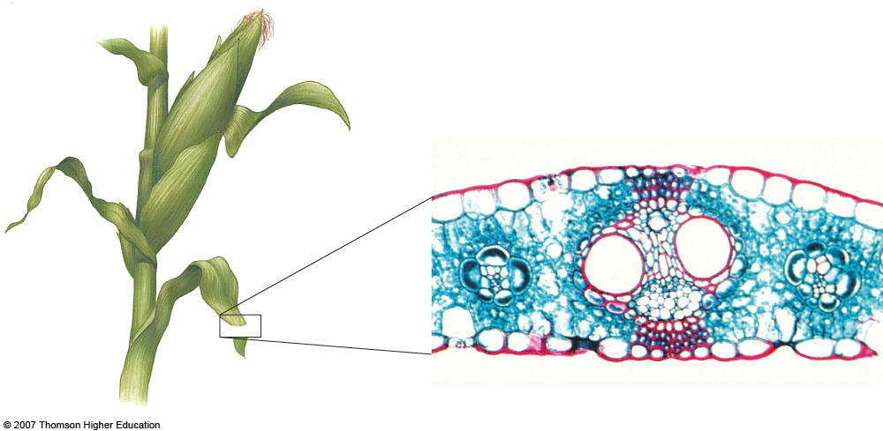
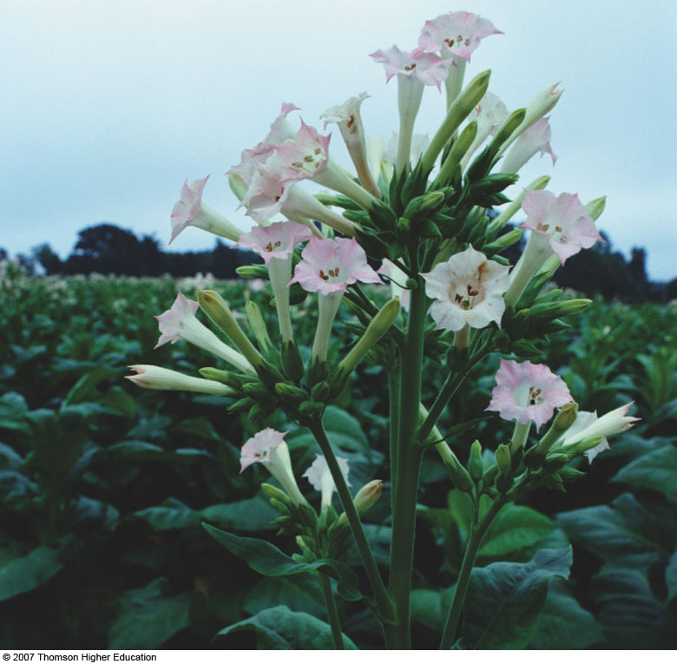
C4 photosynthesis – why the bundle sheath?
Bundle sheath cells
Midvein
Parallel vein
Mesophyll
Upper epidermis
Lower epidermis
Phloem
Xylem

Slide 22
C4 photosynthesis - benefits
PEP carboxylase is not an oxygenase
Good at capturing CO2
Good in low CO2 environments
Good in hot, dry environments
Can close stomata

Slide 23
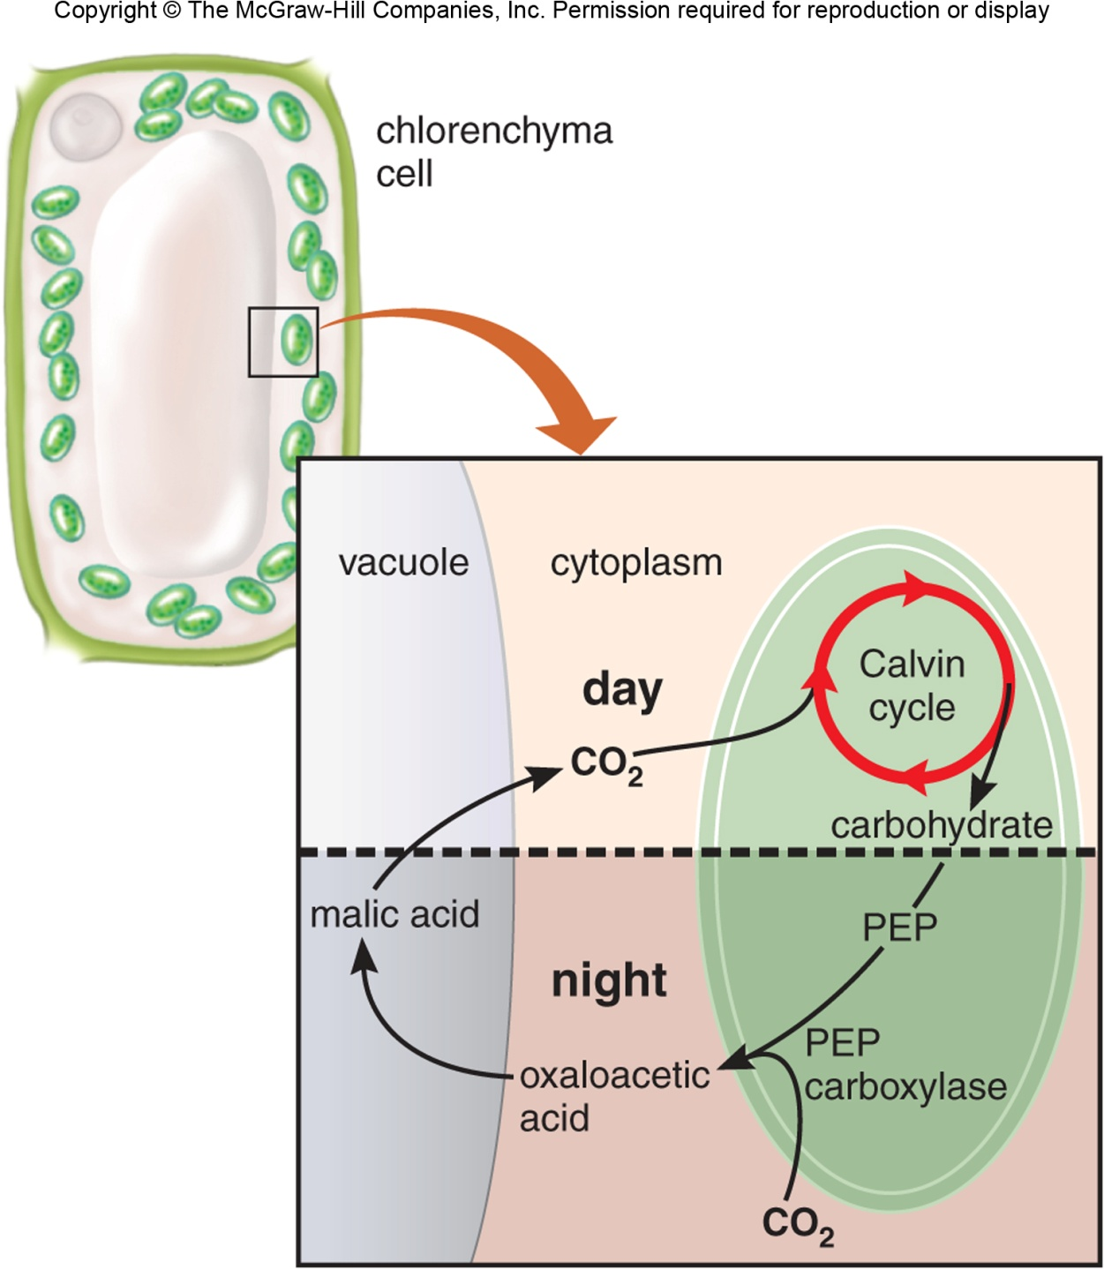
CAM photosynthesis
Opens stomata during the night
PEP carboxylase captures CO₂ and creates a 4 carbon sugar
Closes stomata during the day
Calvin cycle

Slide 24
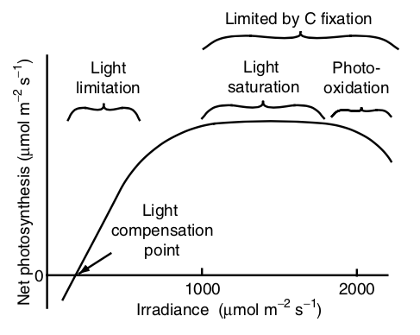
Environmental responses - light

Slide 25
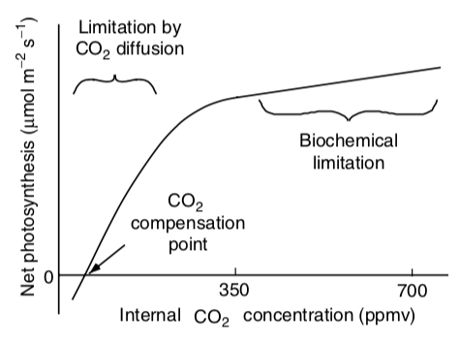
Environmental responses – CO₂

Slide 26
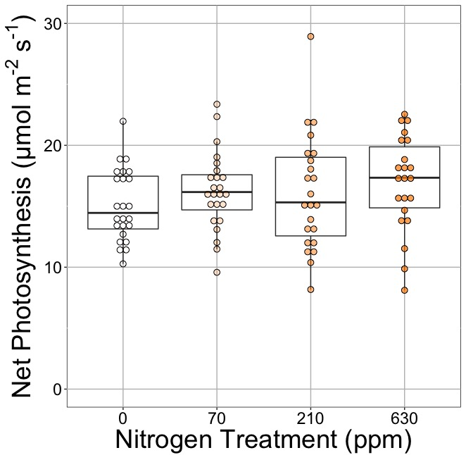
Photosynthesis is less responsive to soil resources (water and nutrients). Why?
Lizz Waring’s postdoc work

Slide 27
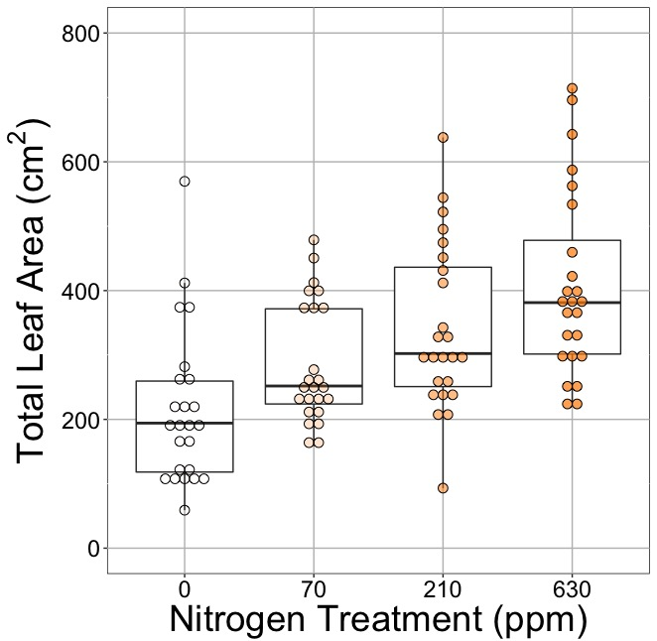
Photosynthesis is less responsive to soil resources (water and nutrients). Why?
Lizz Waring’s postdoc work

Slide 28
GPP = photosynthesis * LAI
Leaf area index (leaf area per ground area)

Slide 29
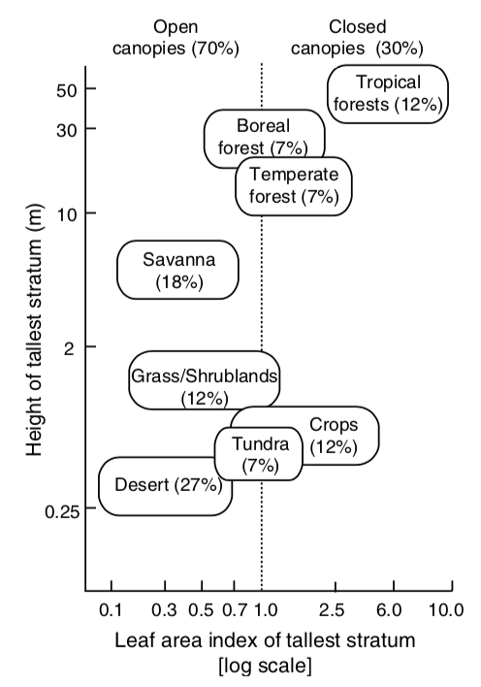
What’s driving the x-axis distribution?

Slide 30
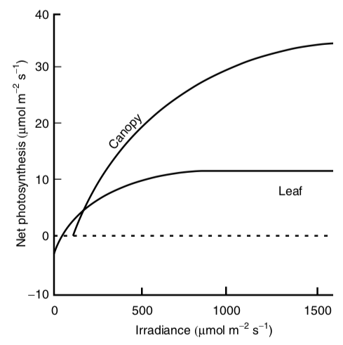
Canopies tend to have higher light use efficiency than leaves

Slide 31
NPP = GPP - R_{plant}
Plant Respiration (total flux of C out of plants ; per ground area)

Slide 32
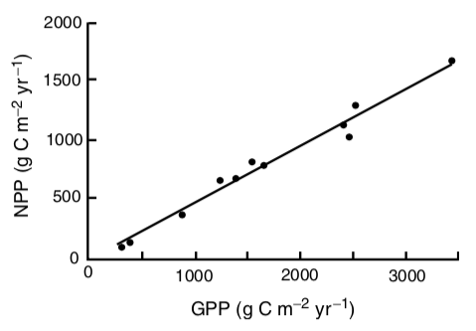
NPP = GPP – 0.5*GPP

Slide 33
What drives NPP?
Over short time scales (seconds to days)
Photosynthesis
Light, temperature, atmospheric conditions
Over long time scales (weeks to months)
LAI
Growth demand
Soil resources

Slide 34
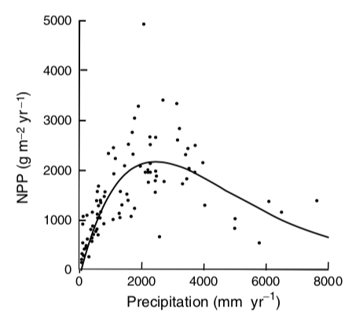

Slide 37
Terrestrial Ecosystem Carbon Cycle

Slide 38
NEP = GPP – (R_{plant} + R_{heterotroph})

Slide 39
NEP = GPP – (R_{plant} + R_{heterotroph})
Net ecosystem production (total flux of C into ecosystem; per ground area)

Slide 40
NEP = GPP – (R_{plant} + R_{heterotroph})
Heterotrophic respiration (C flux out from heterotrophs; per ground area)

Slide 41
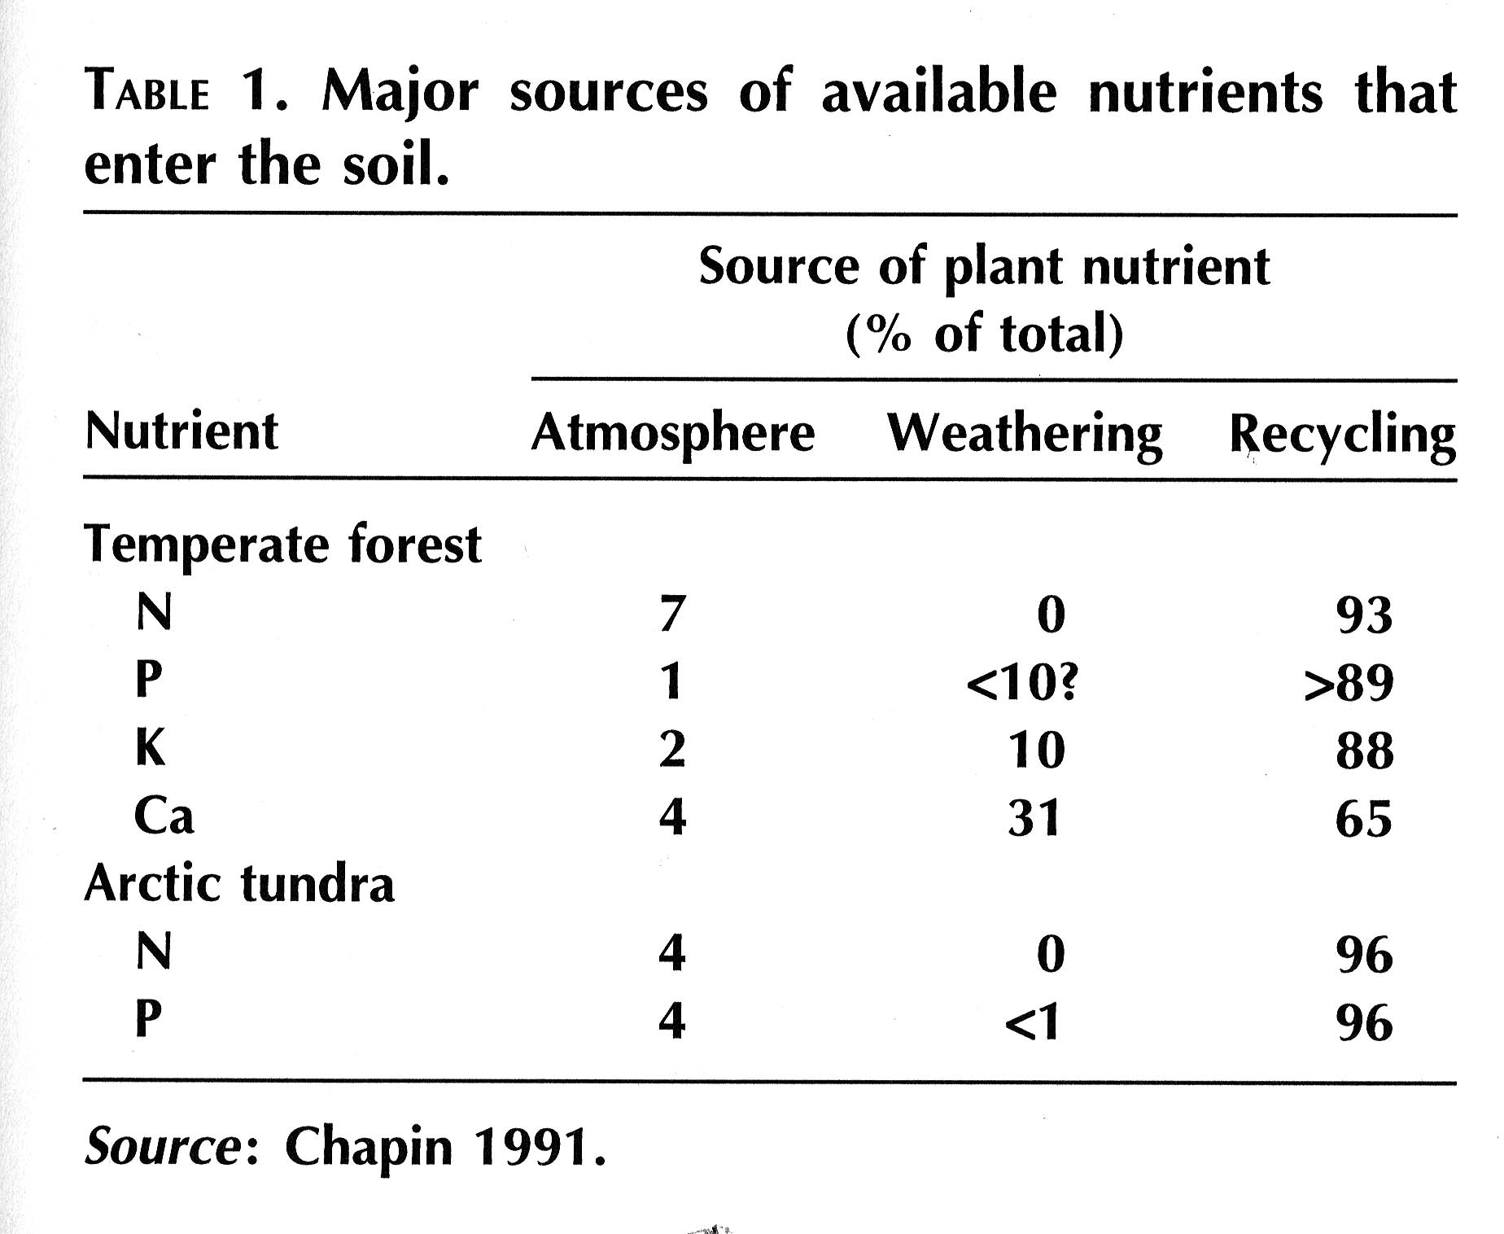
What stands out about this table?

Slide 42
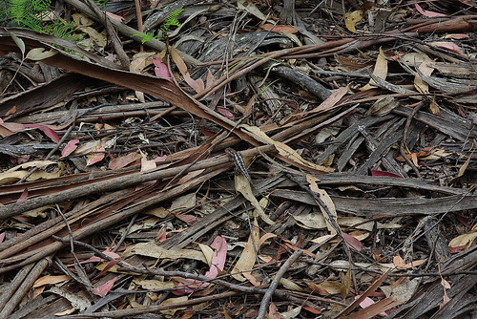
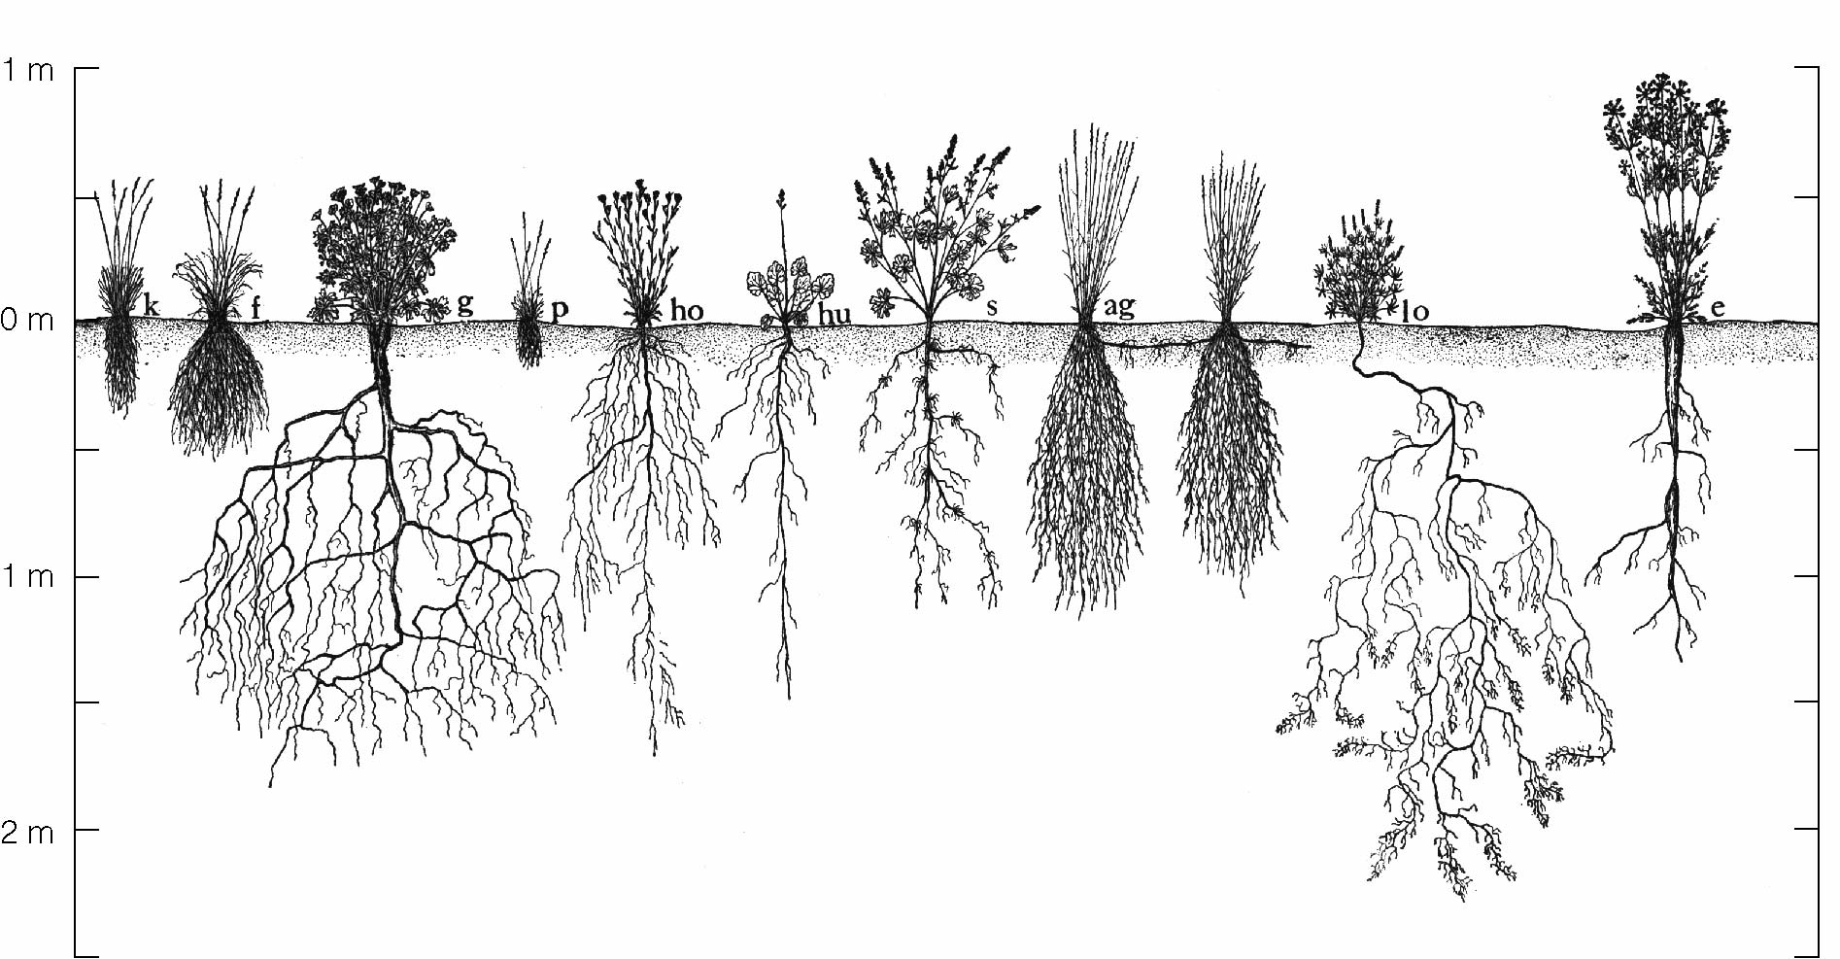
Detritus

Slide 43
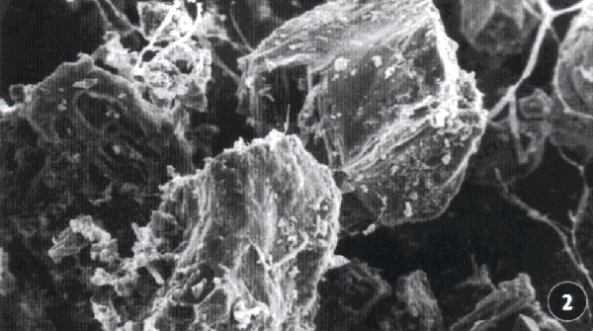
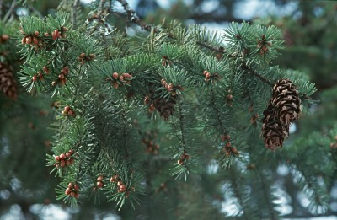
Decomposition of Organic Matter
Decomposition is a process that includes many different biochemical reactions that lead to loss of organic material as CO2 and the release of mineral nutrients and water
Decomposition results from:
Leaching
Fragmentation
Chemical alteration of OM

Slide 44
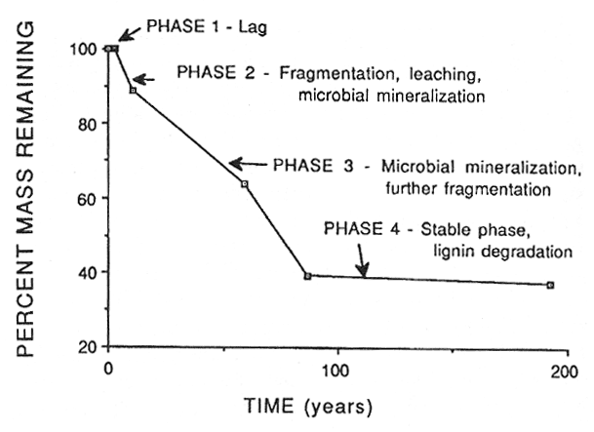

Slide 45
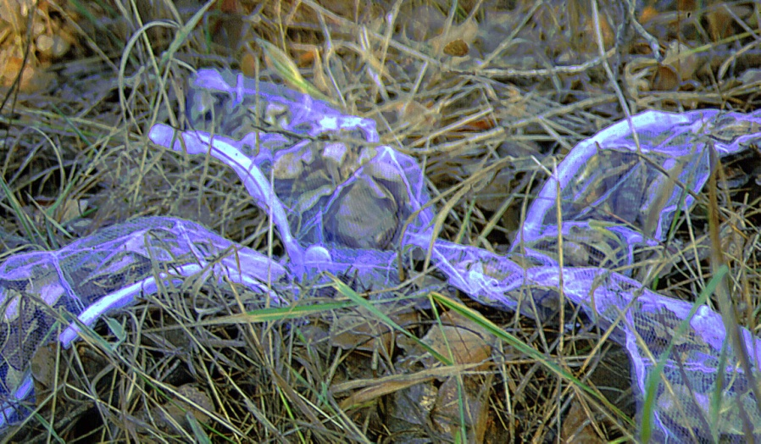
The rate of decomposition

Slide 46
The rate of decomposition
Slope = decomposition rate (K)

Slide 47
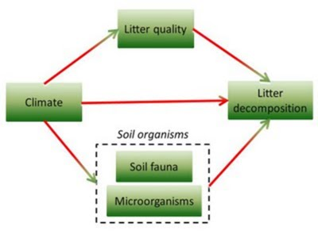
Majors controls of decomposition

Slide 48
Majors controls of decomposition

Slide 49
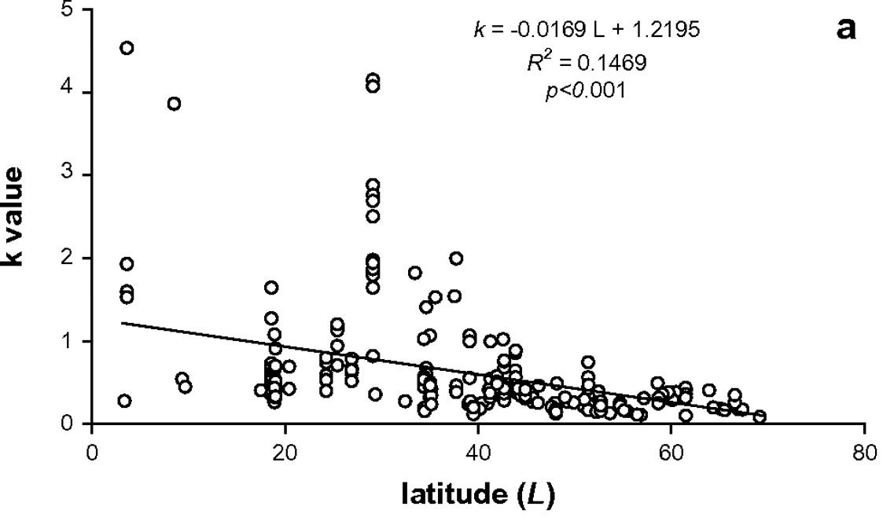
Climate and decomposition
Zhang et al. 2008

Slide 50
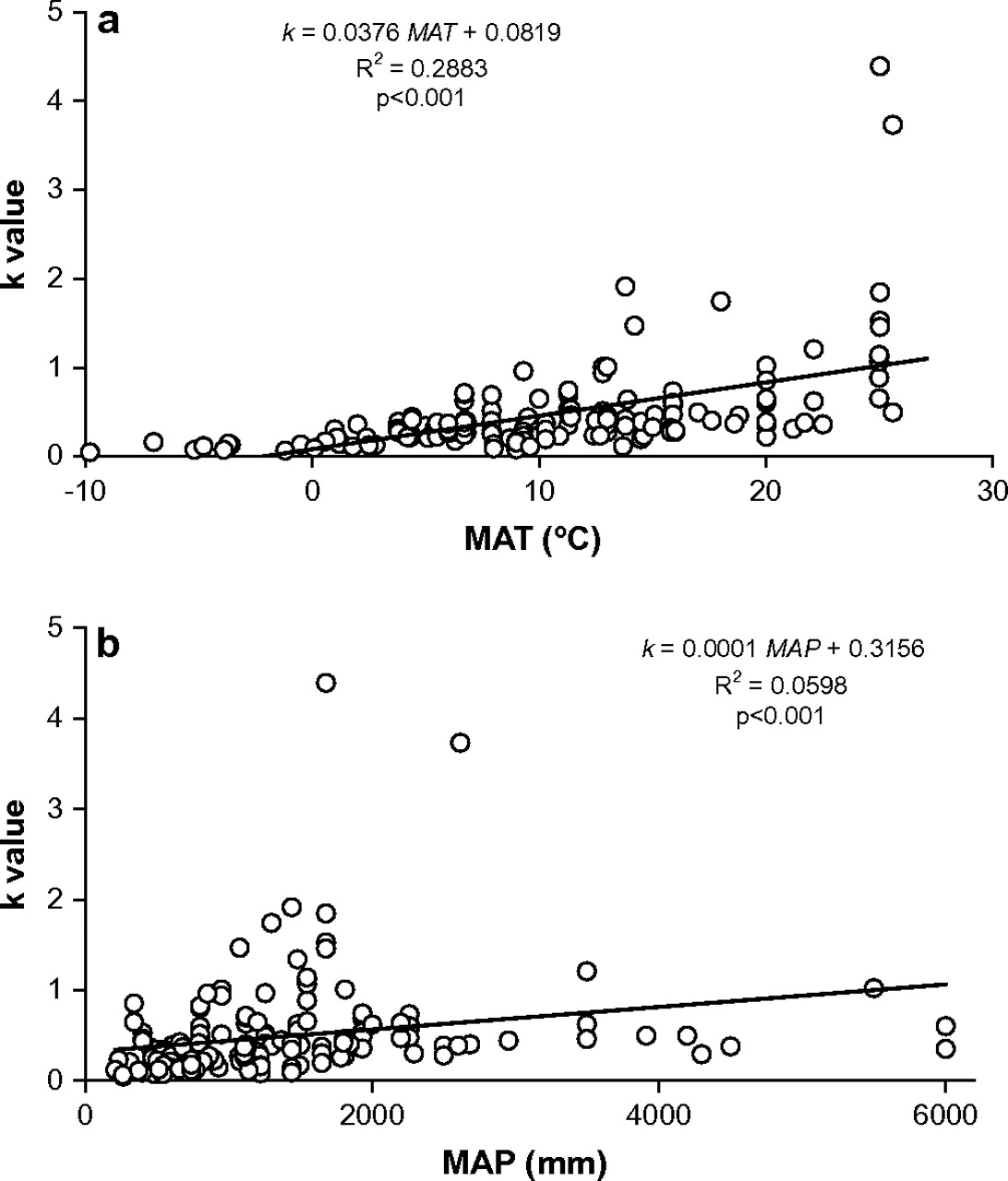
Climate and decomposition
Zhang et al. 2008

Slide 51
Majors controls of decomposition

Slide 52
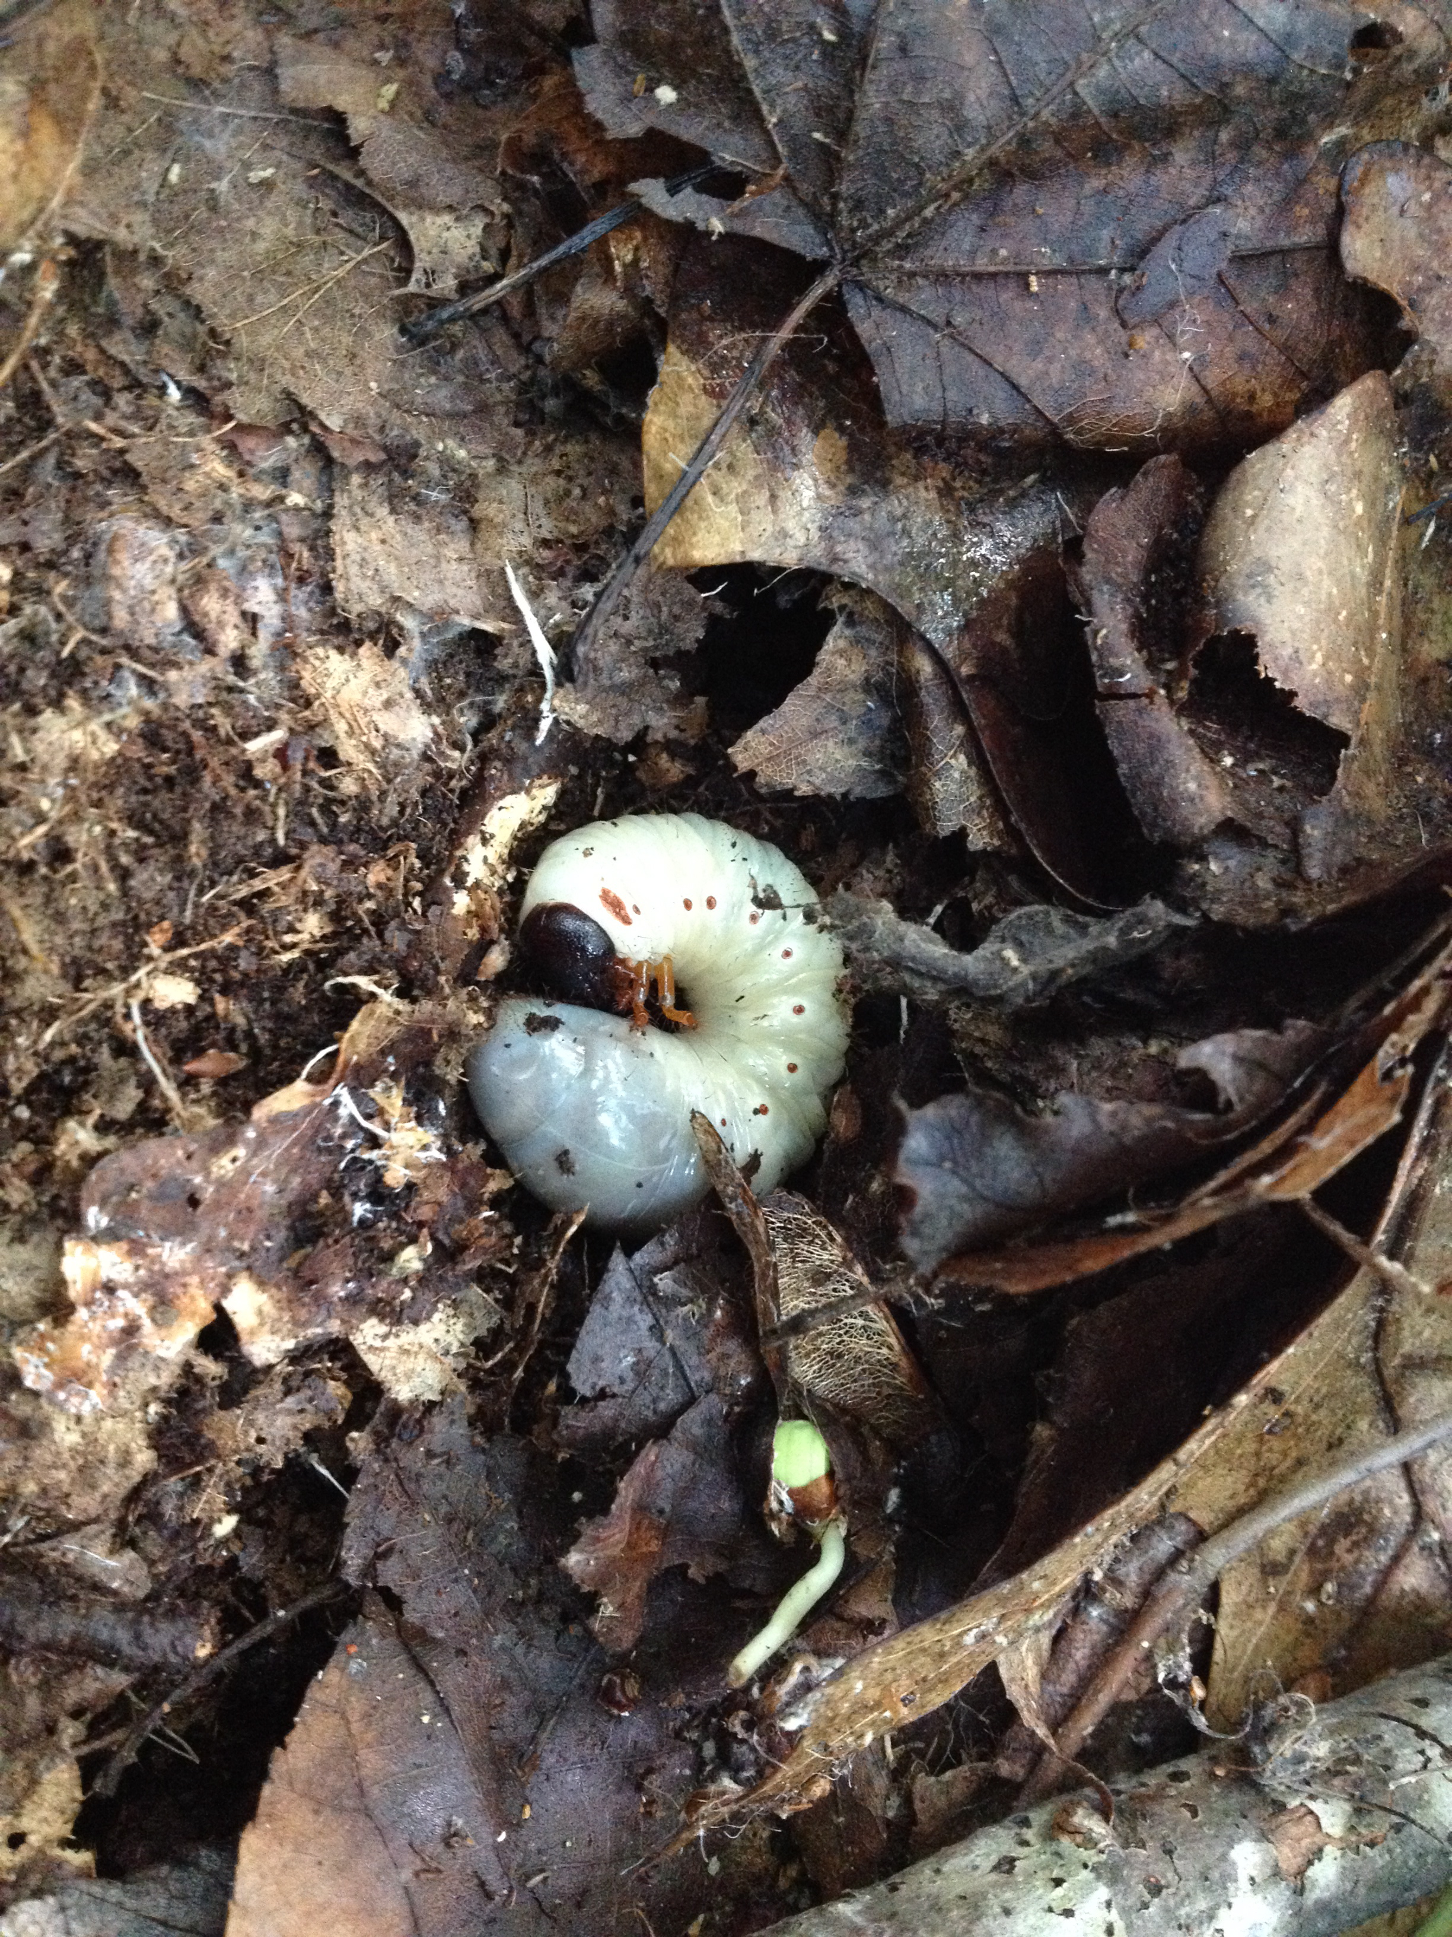
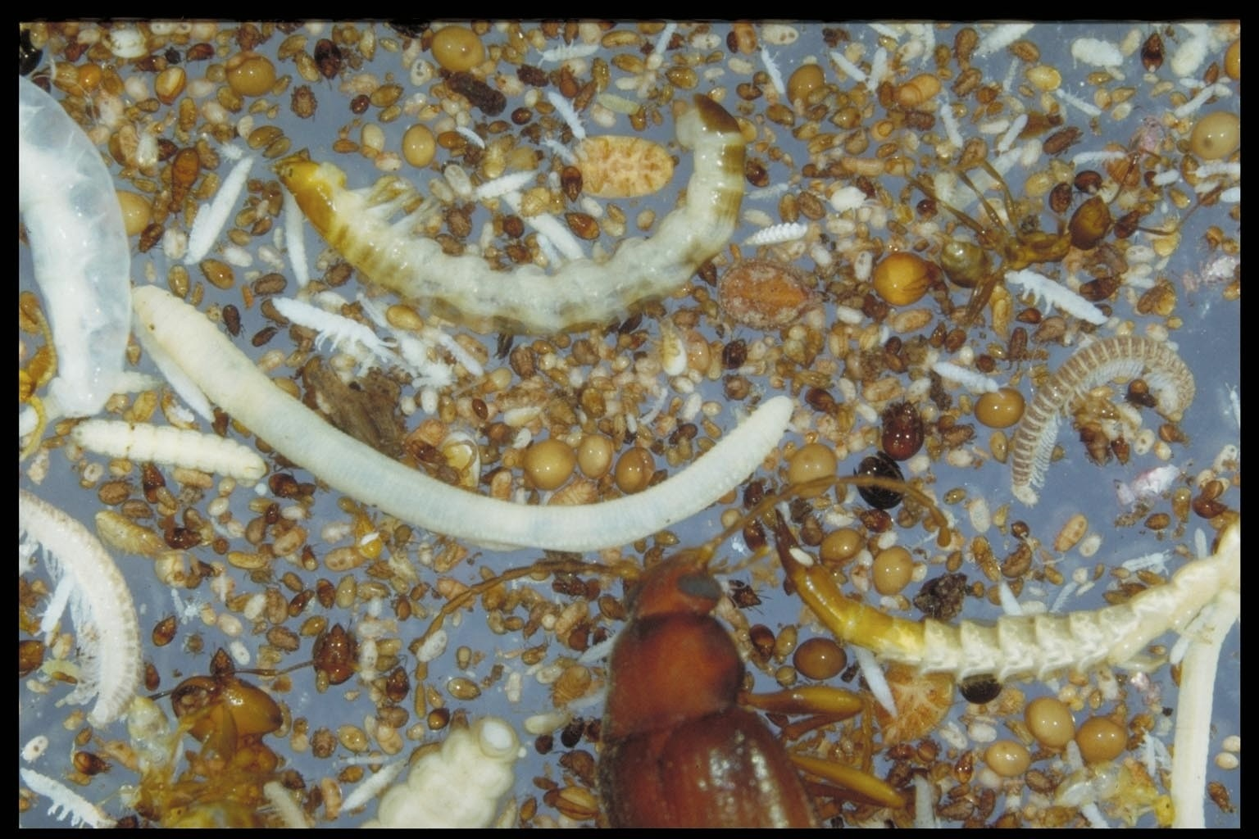
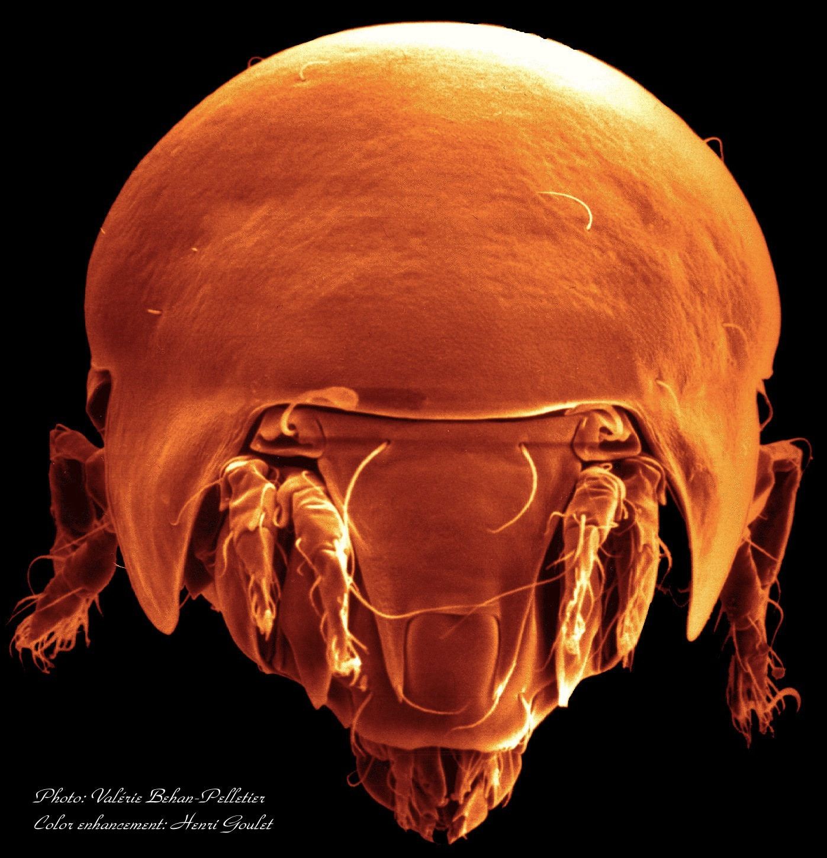
What do soil organisms do?
*Organic matter decomposition
releasing mineral nutrients
stabilize soil structure
humus formation
*Breakdown of toxic compounds
*Inorganic transformations
convert organic N, P, S into plant available forms
*Nitrogen Fixation
capture N₂ from atmosphere
*Plant protection
Photo: D. Bignell

Slide 53
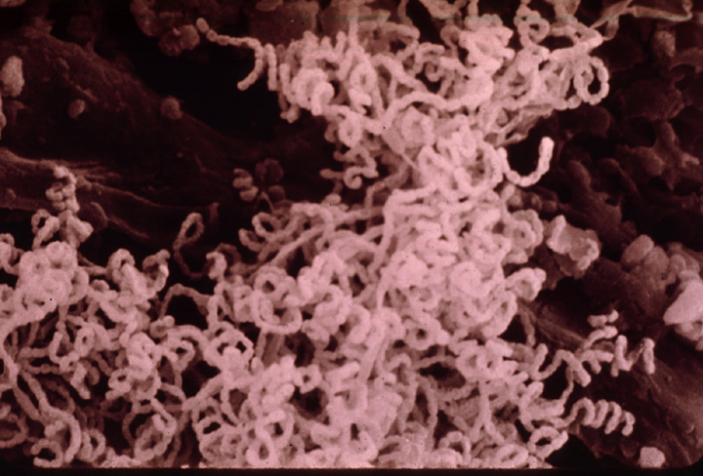
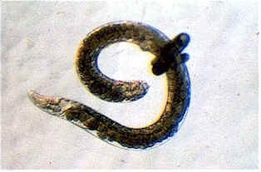
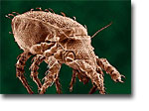
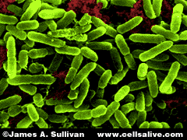
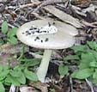
Characteristics of the microbial community determine litter decomposition
-Community composition
-Microbial enzymatic activity
Most of the processes in soil are microbe-mediated and carried out by enzymes they secrete

Slide 54
Extra-cellular enzymes in soils involved in C and N transformations:
Enzymes involved in C transformations
-glucosidase
(1st step in cellulose degradation)
-cellulase
(cellulose to glucose)
-phenol oxidase
(phenolic breakdown)
Enzymes involved in N transformations
-protease
(proteins to polypeptides to amino acids)
-urease
(urea to ammonia)
Microorganisms & plants (especially fungi & yeast)
Primarily fungi, some actinomycetes
Primarily fungi
Nearly all microorganisms
Microorganisms & plants

Slide 55
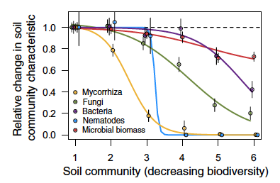
Wagg et al. 2014

Slide 56
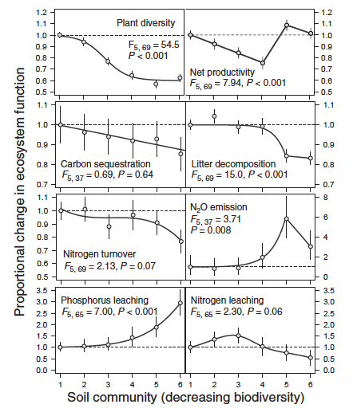

Slide 57
Majors controls of decomposition
Which processes do they regulate?

Slide 58
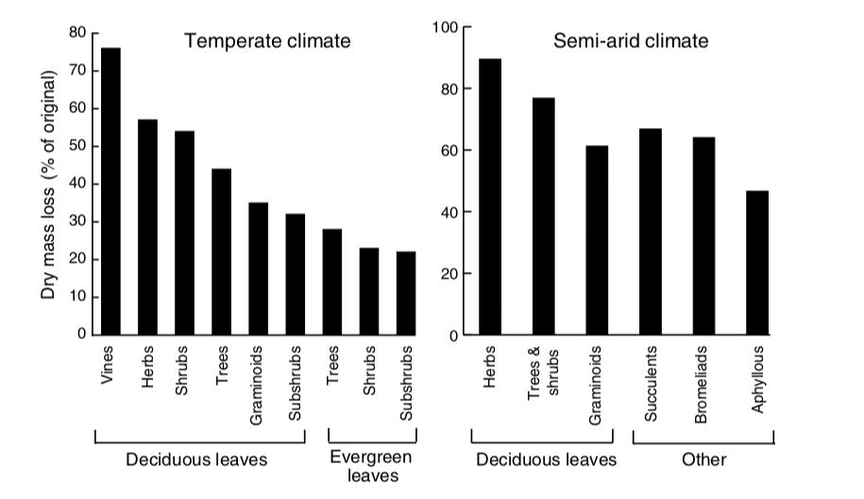
Litter quality varies with plant functional type

Slide 59
Litter quality varies with plant functional type
What’s the trade-off?

Slide 60
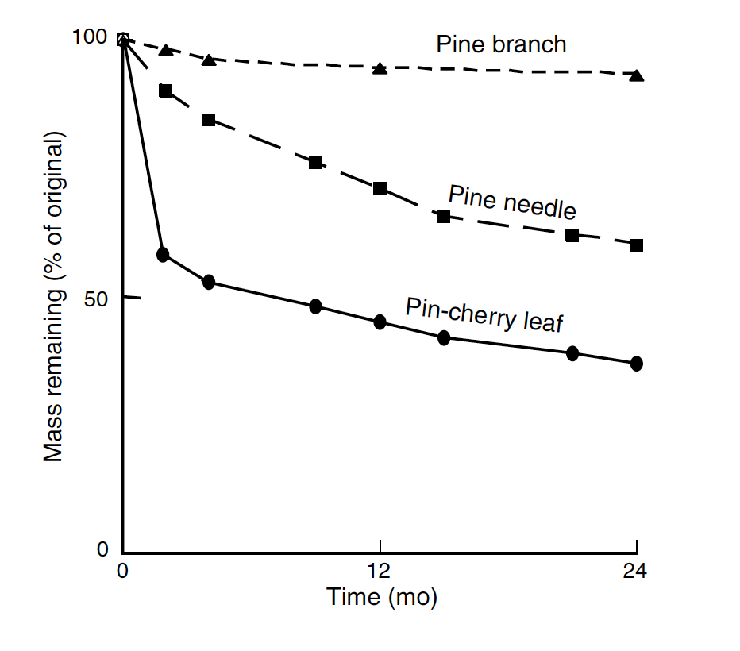
Leaves decompose faster than branches

Slide 61
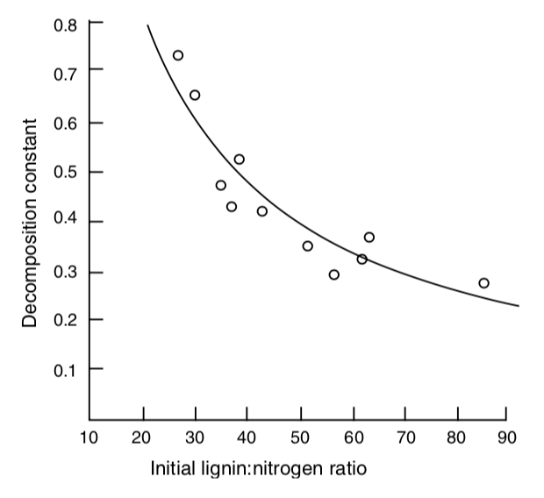
Litter quality and decomposition

Slide 62
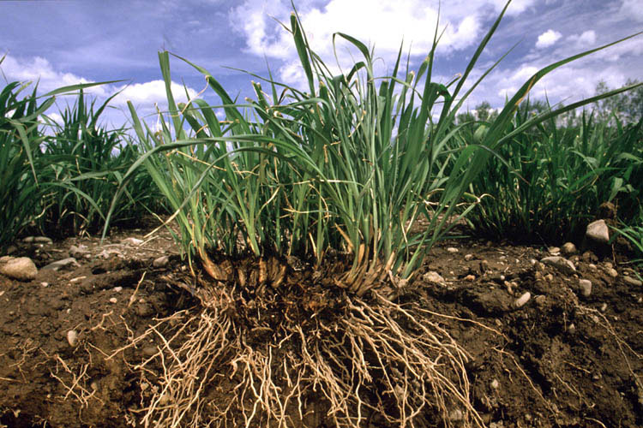
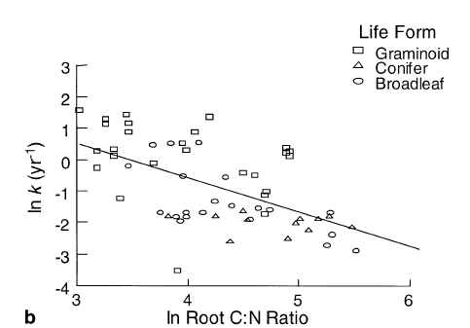
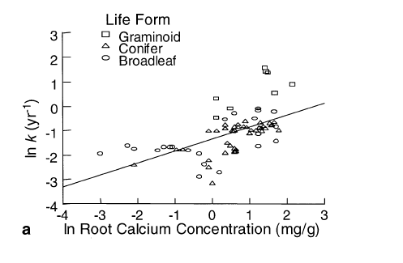
Root quality and decomposition
Silver & Miya 2001

Slide 63
Majors controls of decomposition

Slide 64
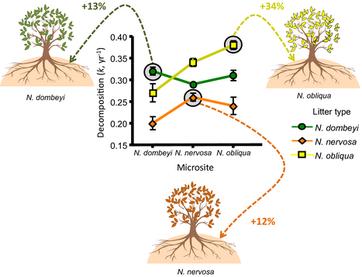
Home Field Advantage
Do microbes decompose substrates that they’ve
“seen” before better than naïve substrates?
(Austin et al. 2014)
Notes:
Nothofagus

Slide 65
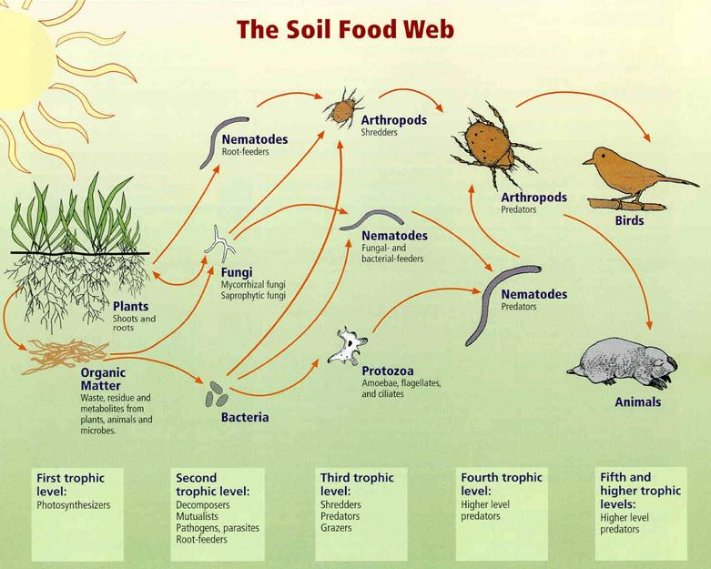
Why is the ground brown?

Slide 66
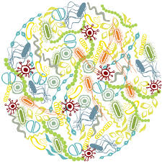
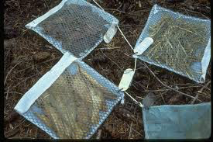
Why is the ground brown?

